Slide 1
Embedded C program for interfacing 4x3 keypad matrix and 16x2 LCD with STM32

Slide 2
Steps for programming STM32
Enable clock for necessary ports.
Reset the GPIO’s that are to be used.
Configure the GPIO’s for input/ output.
Reset the PUPDR register for necessary pins.
Configure the necessary pins for PULL UP/ PULL DOWN with PUPDR.
Monitor the key pressed using Keyscan() driver function
Represent the pressed number in binary format using 4 led’s
Display it on LCD using LCD Driver functions

Slide 3
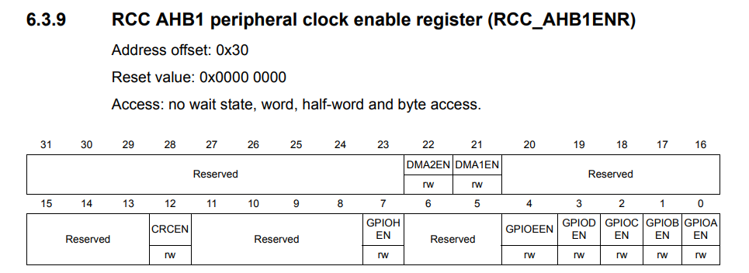
Enabling Clock
RCC->AHB1ENR|=3;
Let us use GPIOB for keypad and GPIOA for LCD.

Slide 4
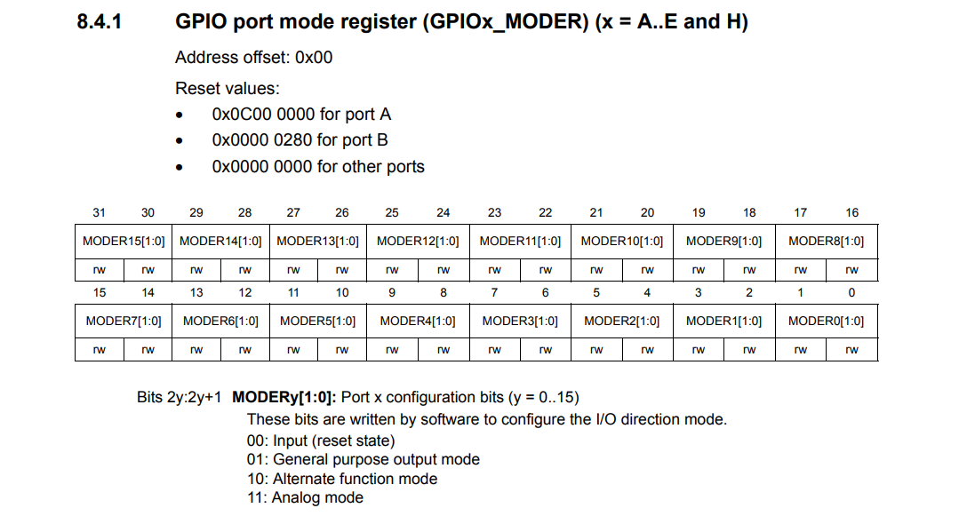

Slide 5
How to Write a value into a register?
GPIOA->MODER = 0X00000001; //which means PA.0 is output
Now if I want PA.3 to be as output then
GPIOA->MODER = 0X00000040;
This will configure PA.3 as output but remove the previous configuration of PA.0.
Instead we can use “&=~” combination read as “and assigned with negation of” to reset particular bits.
We can use “|=“ combination read as “or assigned with” to set particular bits.

Slide 6
How to Write a value into a register?
Objective: make PB.0 to PB.3, PB.12 to PB.15 as outputs and PB.4 to PB.6 as inputs
Steps:
Reset the MODER register of port B pertaining to PB.0 to PB.6 and PB.12 to PB.15
A moder state of “00” for a particular pin is assumed to be the reset state.
GPIOB->MODER&=~(0xFF003FFF);
Configure the MODER register of port B for PB.0 to PB.3, PB.12 to PB.15 as outputs and PB.4 to PB.6 as inputs
“01” for a pin is treated as output.
“00” for a pin is treated as input.
GPIOB->MODER|=(0x55000055);

Slide 7
How to Write a value into a register?
Objective: make PA.0, PA.1 and PA.8 to PA.15 as outputs.
Steps:
Reset the MODER register of port B pertaining to PB.0 to PB.6 and PB.12 to PB.15
A moder state of “00” for a particular pin is assumed to be the reset state.
GPIOA->MODER&=~0XFFFF000F;
Configure the MODER register of port B for PB.0 to PB.3, PB.12 to PB.15 as outputs and PB.4 to PB.6 as inputs
“01” for a pin is treated as output.
“00” for a pin is treated as input.
GPIOA->MODER|=0X55550005;

Slide 8
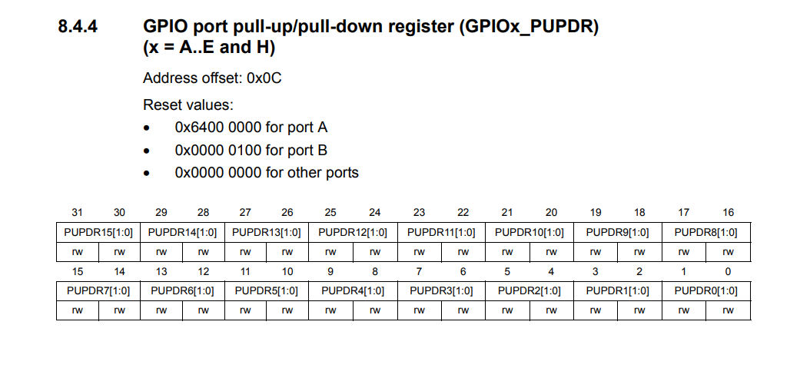

Slide 9
Configuring pull up and pull down registers
Why should I configure PUPDR?
When I don’t press the switch, the default value of the switch is depended on whether the pin is pulled up or pulled down.
What are the default values?
Pulled up pin: Default value is “0”.
Pulled down pin: Default value is “1”.
“00” is for No pull up No pull down
“01” is for Pull-Up
“10” is for Pull-Down
“11” is Reserved
Reset PUPDR
GPIOB->PUPDR&=~(0X00003F00);
Configure PUPDR
GPIOB->PUPDR|=0X00001500;

Slide 10
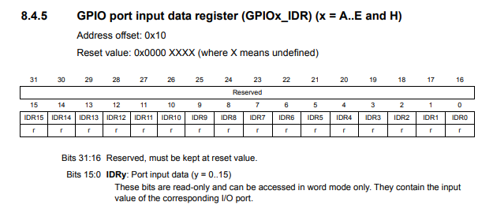
Monitoring IDR

Slide 11
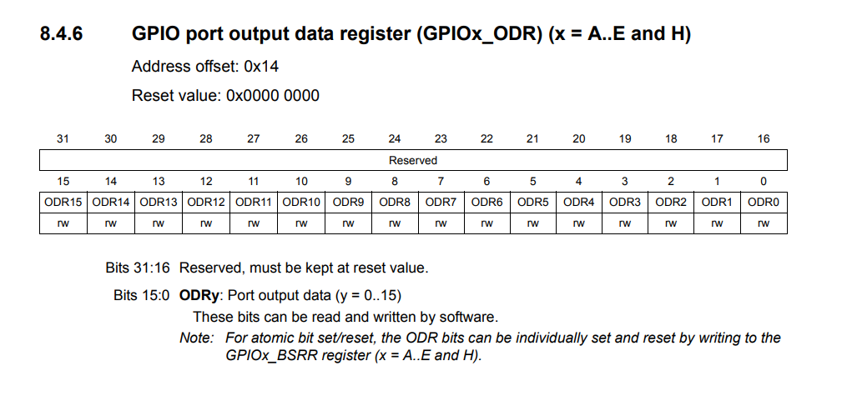
Configuring ODR

Slide 12
Keyscan() algorithm development
Configure Rows as Outputs and Columns as Inputs
Make all the rows as “0”
Once a column pin becomes “0” make rows “0” one by one and monitor IDR to find the exact row responsible for column activation
Wait until any one of the column pins become “0”
Once the column pin is found, row which is made 0 and column which is reading 0, combination position must be identified
Return that particular number
GPIOB->ODR&=!0X000000F;
while((GPIOB->IDR&0X70)==0X70);
GPIOB->ODR|= 0X0E; GPIOB->ODR|= 0X0D;
GPIOB->ODR|= 0X0B; GPIOB->ODR|= 0X07;
Return x;
temp = GPIOB->IDR & 0X70;

Slide 13
Developing LCD Driver functions
lcdprint(ch)
Left shift the data by 8 bits
Send pulse on enable pin
Make RS high to say its data
Load the data
sendcmd(ch)
Left shift the data by 8 bits
Load the data
Make RS low to say its cmd
Send pulse on enable pin
lcdinit()
Send initialisation commands
sendcmd(0x38);//16 column 2 row mode
sendcmd(0x0F);//display on cursor blinking
sendcmd(0x06);//auto increment
sendcmd(0x01);//clear display
printstr(*ch)
Loop till the string ends
Print the string
Character by character

Slide 14
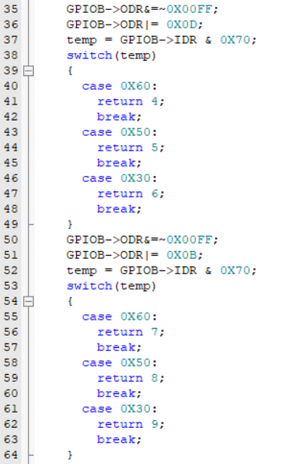
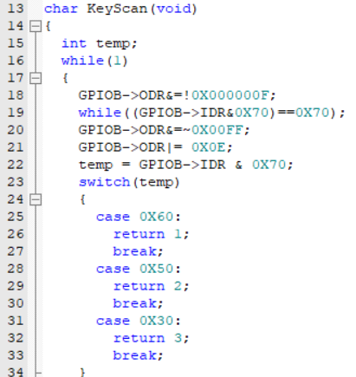
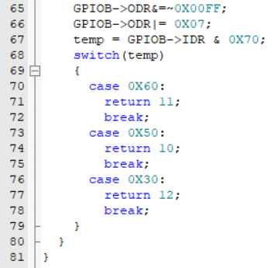
Keyscan() Logic

Slide 15
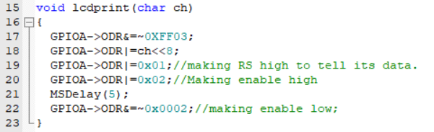
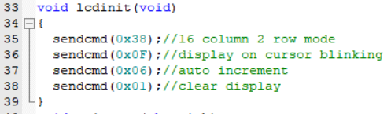
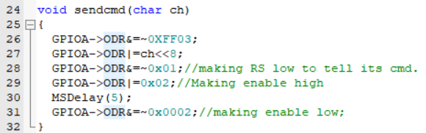
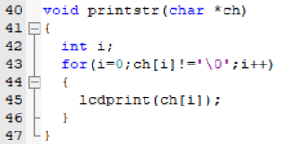
LCD Driver function codes
Displaying a character function
Lcd initialisation function
Sending a command function
Printing a string function

Slide 16
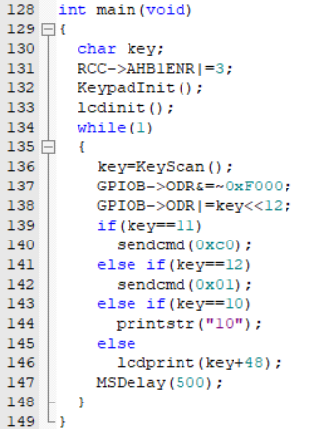
Writing the scanned key value onto LED’s and LCD

Slide 17
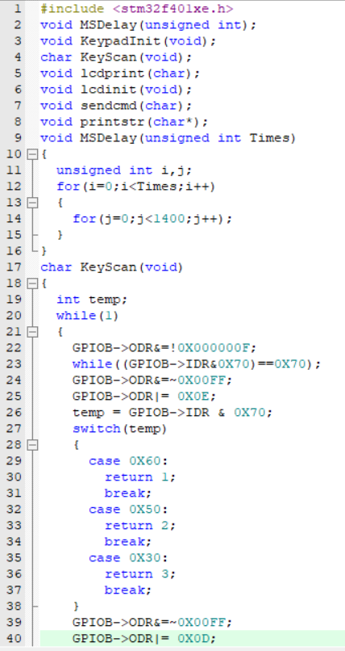
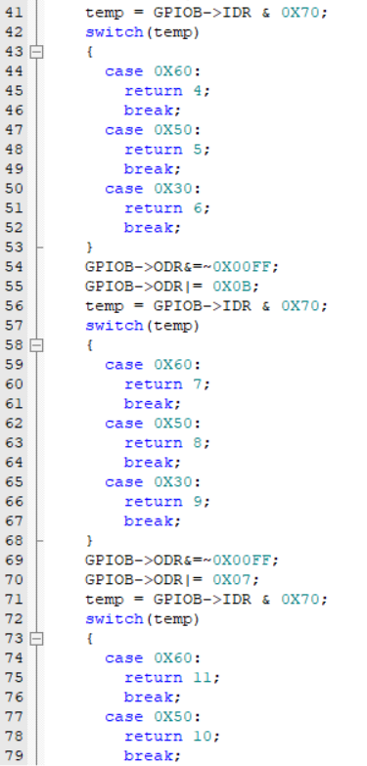
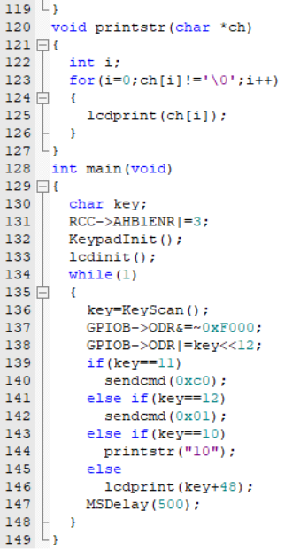
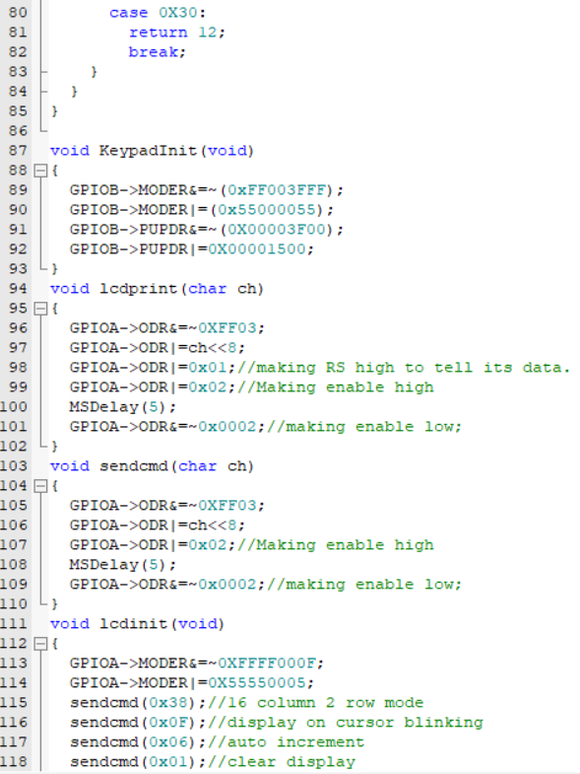
Final Code

Slide 18

Please Subscribe to my channel……..
Like Share Comment Subscribe

